Slide 1
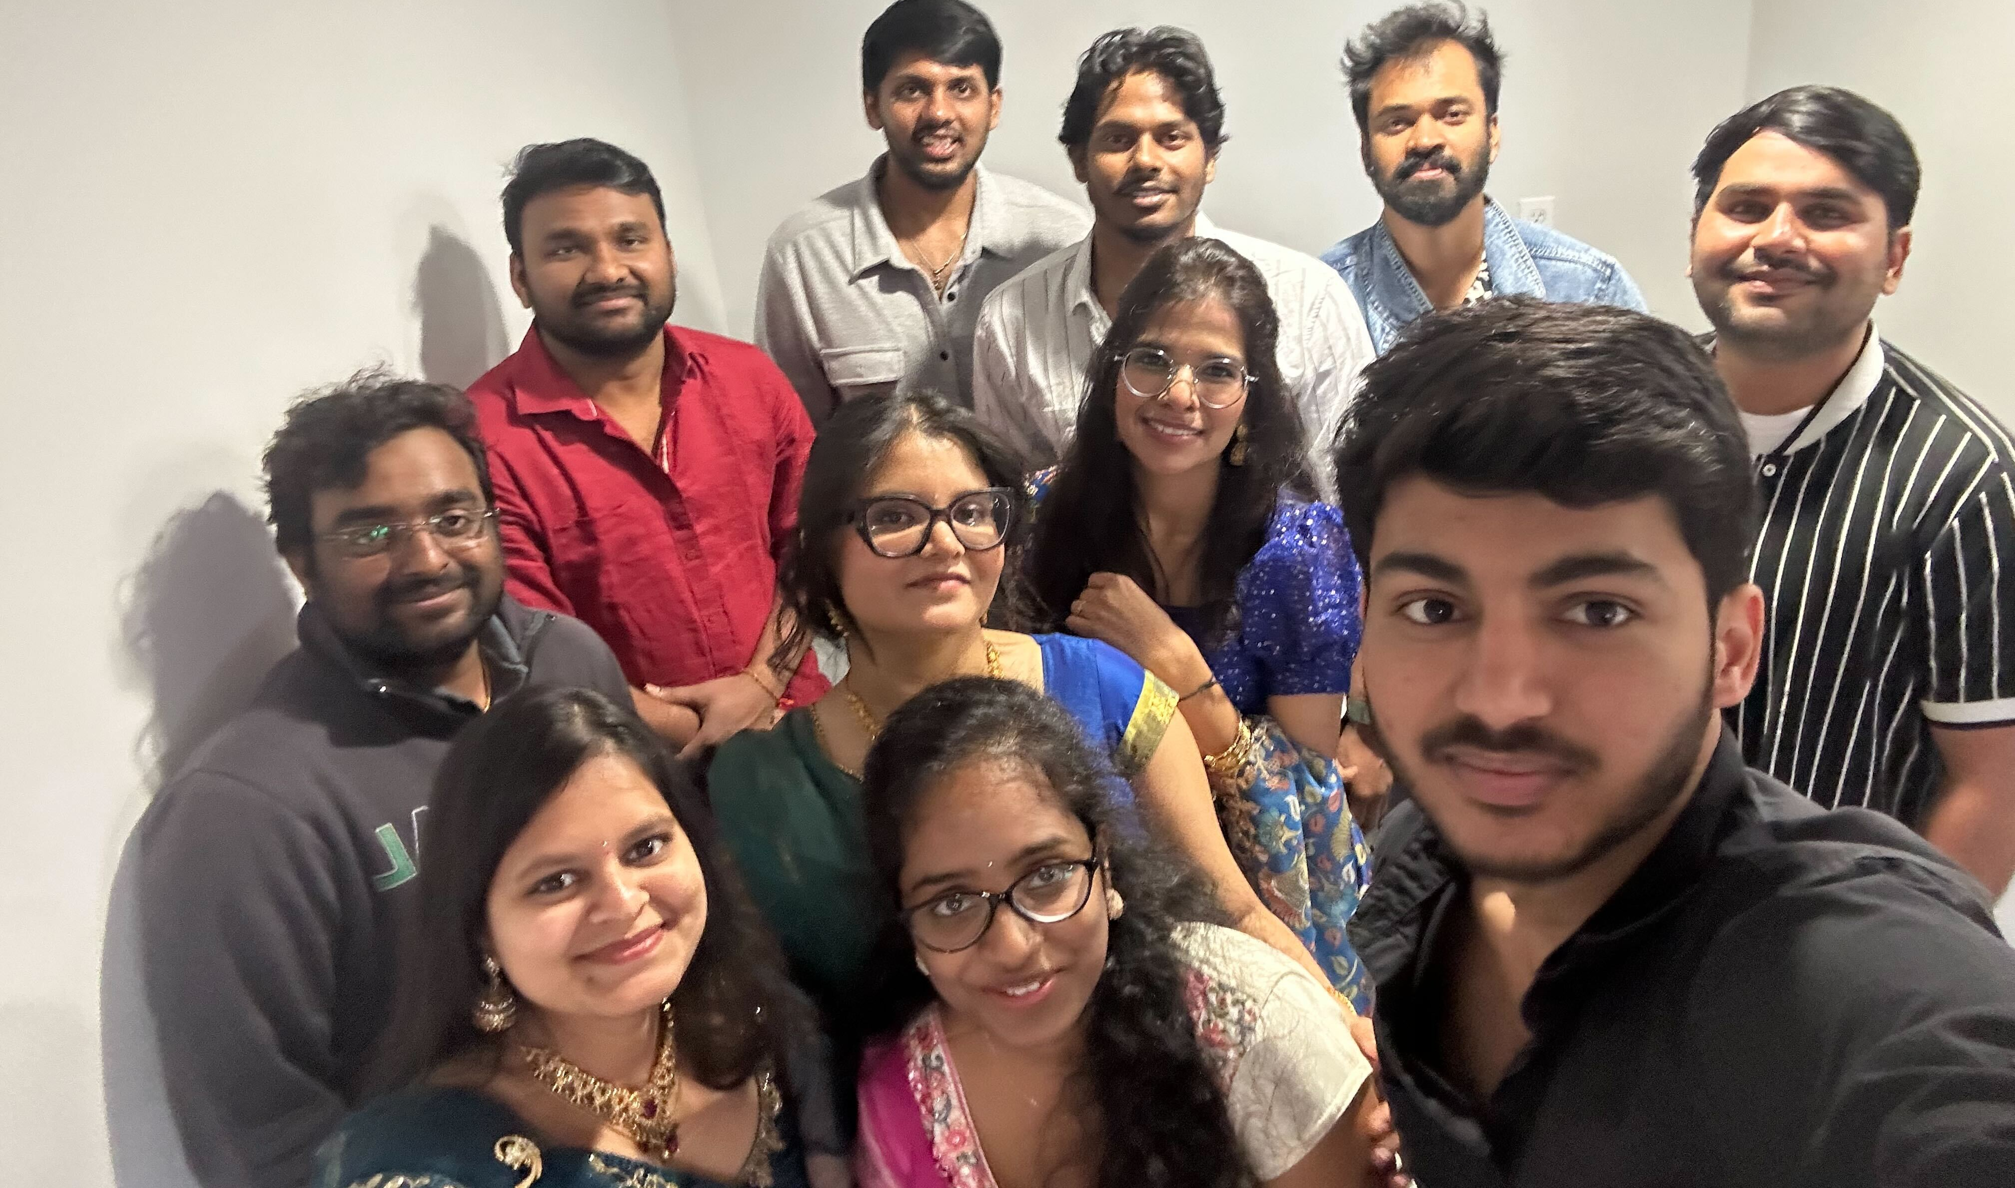
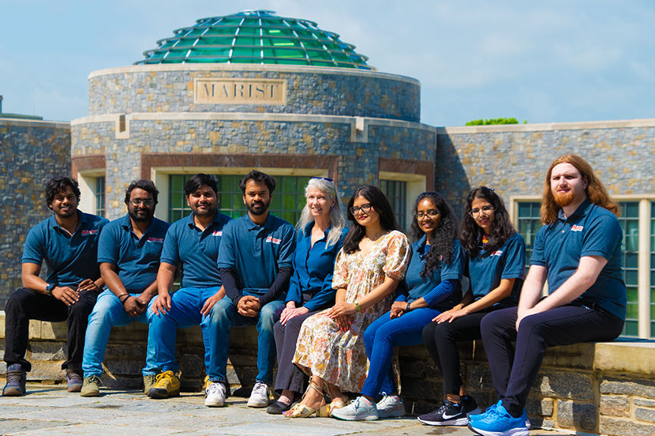
By Students, For Faculty
A Rapid Brightspace Transition
Notes:
Overview:
Transitioning to a new learning management system is a daunting task, even more so when there is a compressed timeline. Many institutions warned the cost, time, and accuracy of data migration is the biggest challenge in transitioning materials from a legacy LMS.
In early 2023 Marist College’s Digital Education department was given the mandate to rapidly transition to Brightspace with a full implementation by mid-August 2023. We developed an innovative plan to quickly deliver imported course materials to our faculty in a usable fashion. This presentation will share the steps we took to organize, implement, and successfully transition to Brightspace using a diverse pool of local and international student workers.

Slide 2
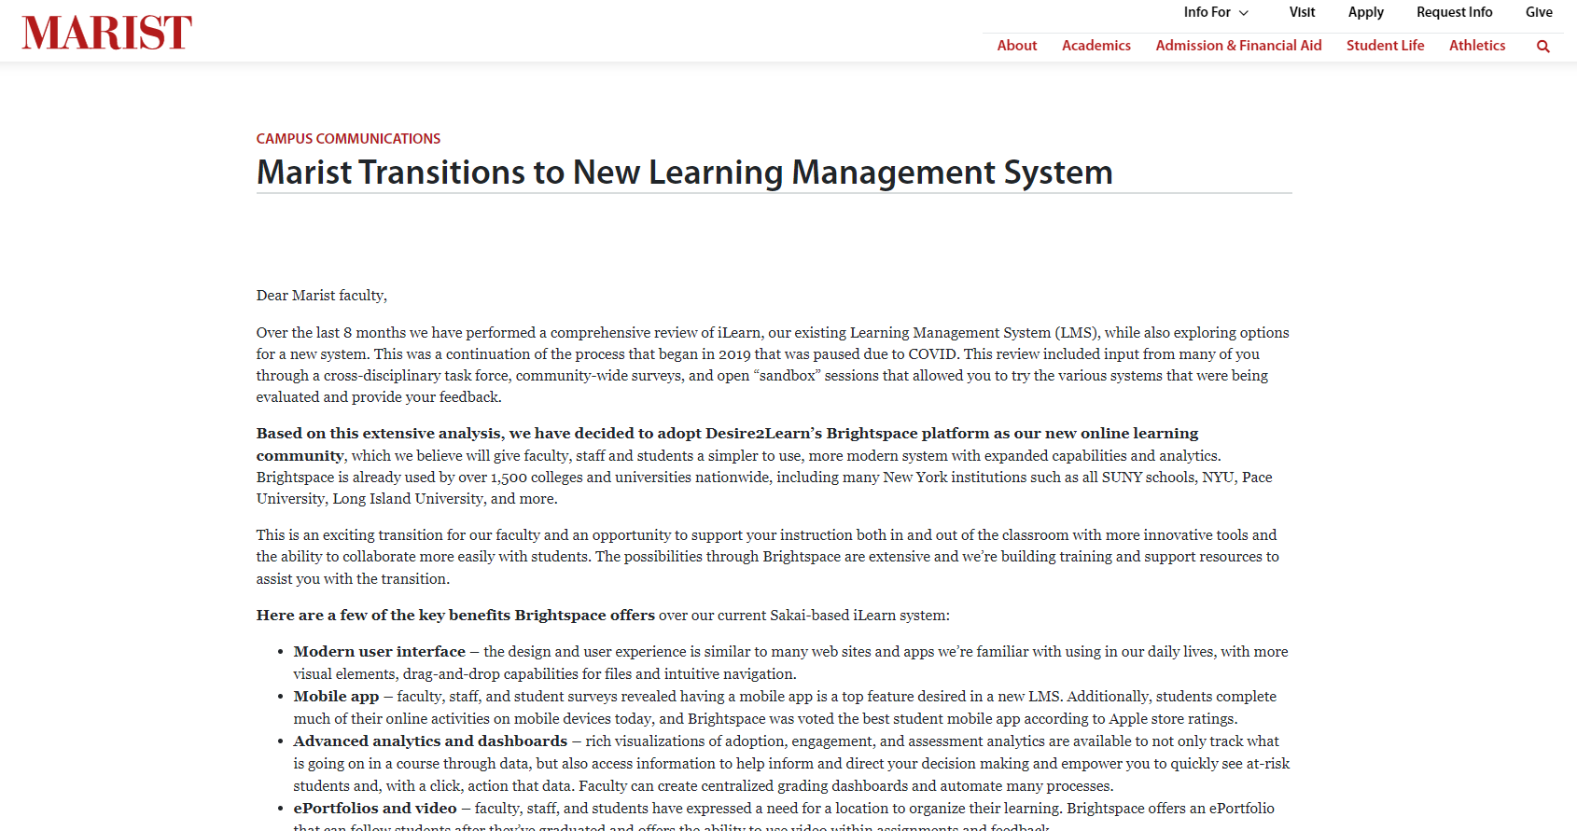

How it Started
Notes:
History and Challenges:
After a yearlong review of our LMS, the college chose to move forward with Brightspace platform. The complete transition deadline was set for 180 days, which meant that the initial roll out would need to be completed within 90 days. To meet this tight deadline, we turned to our student employees. Digital Education historically employed student workers to quality assurance test our legacy LMS.
Our migration to a new LMS was rooted in a manual process. Our biggest challenge as LMS administrators was the bulk migration of content from the previous LMS to Brightspace which required significant manual cleanup after the transfer. To limit the faculty overload for importing and manually reviewing their course content, our student employees were trained in importing, organizing, and editing the course materials. The successful transition to Brightspace was due to the process and procedures used to organize the student’s tasks, build automated communications, and the streamlined migration of content from our previous system.

Slide 3
Solution:
Student Staff
Utilizing our student employees, skilled quality assurance testing to export, import, and clean an entire year’s worth of content.
Notes:
Solution:
We utilized our student employees skilled quality assurance testing to export, import, and clean an entire year’s worth of content within the Brightspace course offering sites. In addition to courses, the student employees also separately processed project sites, rubrics, quizzes, and question pools. These same students went on to train the faculty, support Open Lab sessions, participate in online training sessions, and provide just-in-time in-office assistance.
Our solution meets the mission:
As an institution, our goal is to provide our students with experiential learning opportunities that will carry over into the workforce. This LMS migration offered our student employees an experience in learning quality assurance techniques that reflect real-world job skills that are applicable to many career paths.

Slide 4

Solution
The Ideas
Manual Import
  Reorder
  Remove
  Rename
  Recreate
Notes:
Solution:
We utilized our student employees skilled quality assurance testing to export, import, and clean an entire year’s worth of content within the Brightspace course offering sites. In addition to courses, the student employees also separately processed project sites, rubrics, quizzes, and question pools. These same students went on to train the faculty, support Open Lab sessions, participate in online training sessions, and provide just-in-time in-office assistance.

Slide 5

JANUARY
2023
S | M | T | W | T | F | S
 | 1 | 2 | 3 | 4 | 5 | 6
7 | 8 | 9 | 10 | 11 | 12 | 13
14 | 15 | 16 | 17 | 18 | 19 | 20
21 | 22 | 23 | 24 | 25 | 26 | 27
28 | 29 | 30 | 31
Notes:
Contract is signed

Slide 6









FEBRUARY
February
2023
2023
S | M | T | W | T | F | S
 |  |  |  | 1 | 2 | 3
4 | 5 | 6 | 7 | 8 | 9 | 10
11 | 12 | 13 | 14 | 15 | 16 | 17
18 | 19 | 20 | 21 | 22 | 23 | 24
25 | 26 | 27 | 28 | 29
S | M | T | W | T | F | S
 | 1 | 2 | 3 | 4 | 5 | 6
7 | 8 | 9 | 10 | 11 | 12 | 13
14 | 15 | 16 | 17 | 18 | 19 | 20
21 | 22 | 23 | 24 | 25 | 26 | 27
28 | 29 | 30 | 31
Notes:
Feb is when DE Team started training on Brightspace

Slide 7

3
Months
Marist Brightspace configured, and the first courses offered in Brightspace
90 days
2023: February-April

Slide 8

LMS PROJECT TIMELINE
JANUARY-FEBRUARY
2023
PHASE I: SPRING 2023 LMS TRANSITION
Streamlined process for training the trainers
The contract was signed January 31, 2023, and Marist College received resources from D2L on February 7, 2023.
Digital Education immediately began extensive training with D2L trainers and the first phase of the transition to Brightspace began with summer courses.
Marist started to develop the site branding design and SSO configurations and SIS integrations for users and courses.
Documentation
Notes:
Projects, numbers and timeline:
Fall Courses – 45 Days (April – Mid May), Number of Courses – 1074 2.
4R’s - Reorder, Remove, Rename and Recreate Content – 45 Days (April – Mid May) , Number of Courses – 1074 3. Question Pools - 4months (April – July) Number of Courses – 225 , Number of Question Pools created – 3,296 4. Winter and Spring Courses – 70 days (Sept – Nov) Number of Courses – 1388 5.Non – credit courses and project sites – Entire Fall Semester , Number of Courses – 156 6.Brightspace open labs and workshops – Entire Fall and Spring Semester 7.Bright Foxes – Fall Semester Number of workshops – 3 (edited)
The Digital Education department’s ability to create an efficient and effective plan while rapidly adapting to new technologies was demonstrated in its successful transition to the LMS in just under 6 months. Involving student employees in the process further aligned with the Marist College's commitment to excellence in education and collaboration within their academic community.

Slide 9

MARCH
2023
Unit 1
S | M | T | W | T | F | S
 |  |  |  |  | 1 | 2
3 | 4 | 5 | 6 | 7 | 8 | 9
10 | 11 | 12 | 13 | 14 | 15 | 16
17 | 18 | 19 | 20 | 21 | 22 | 23
24 | 25 | 26 | 27 | 28 | 29 | 30
31
Lesson 1
Topic 1
Unit 2
Notes:
FALL 22 Courses - 1074

Slide 10
APRIL
2023
Unit 1
S | M | T | W | T | F | S
 | 1 | 2 | 3 | 4 | 5 | 6
7 | 8 | 9 | 10 | 11 | 12 | 13
14 | 15 | 16 | 17 | 18 | 19 | 20
21 | 22 | 23 | 24 | 25 | 26 | 27
28 | 29 | 30
Lesson 1
Topic 1
Unit 2
Notes:
FALL 22 Courses - 1074
Question Pools - 3,296

Slide 11

may
2023
Unit 1
S | M | T | W | T | F | S
 |  |  | 1 | 2 | 3 | 4
5 | 6 | 7 | 8 | 9 | 10 | 11
12 | 13 | 14 | 15 | 16 | 17 | 18
19 | 20 | 21 | 22 | 23 | 24 | 25
26 | 27 | 28 | 29 | 30 | 31
Lesson 1
Topic 1
Unit 2
Notes:
FALL 22 Courses - 1074
Question Pools - 3,296

Slide 12

4
Months
Digitial Education Staff and Student Employees trained 684 Instructors
2023: June-October

Slide 13


APRIL- MAY 2023
Fall 2023 Courses
Student staff quality assurance tested 1,074 Fall 2022 course offerings. These courses were re-structured using Course Builder Tool to clean misaligned content.
Reorder
Remove
Rename &
Recreate
4R’s
Question Pool Creation
225 Courses with
3,296 Question Pools
Notes:
Fall Courses – 45 Days (April – Mid May),
Number of Courses – 1,074
4R’s - Reorder, Remove, Rename and Recreate Content – 45 Days (April – Mid May) ,
Number of Courses – 1074
Question Pools - 4months (April – July) Number of Courses – 225 ,
Number of Question Pools created – 3,296
On April 10, 2023, the first high level milestone was met as Marist Brightspace was launched. The environment was completed with customized college specific requirements.
In May, Digital Education deployed workshops, tutorials and other training resources to ensure a smooth transition for all instructors, students, and staff. Both synchronous training and asynchronous training materials were available. The Digital Education department targeted summer instructors for the first phase of training. Additionally, Digital Education created an online student orientation for the students to become familiar with the new digital learning environment. During this time, the department also created and maintained numerous webpages about the transition timeline, trainings, and links to tutorials and resource guides to use the new LMS.

Slide 14


JUNE
2023
Unit 1
S | M | T | W | T | F | S
 | 1 | 2 | 3 | 4 | 5 | 6
7 | 8 | 9 | 10 | 11 | 12 | 13
14 | 15 | 16 | 17 | 18 | 19 | 20
21 | 22 | 23 | 24 | 25 | 26 | 27
28 | 29 | 30
Lesson 1
Topic 1
Unit 2

Slide 15

July
2023
S | M | T | W | T | F | S
 |  |  |  |  | 1 | 2
3 | 4 | 5 | 6 | 7 | 8 | 9
10 | 11 | 12 | 13 | 14 | 15 | 16
17 | 18 | 19 | 20 | 21 | 22 | 23
24 | 25 | 26 | 27 | 28 | 29 | 30
31
Unit 1
Lesson 1
Topic 1
Unit 2
Notes:
FALL 22 Courses - 1074
Question Pools - 3,296

Slide 16

5
Months
Digitial Education Staff and Student Employees
transitioned & quality assurance tested
2,917
previous course content into Brightspace
150 days
2023: July-November

Slide 17

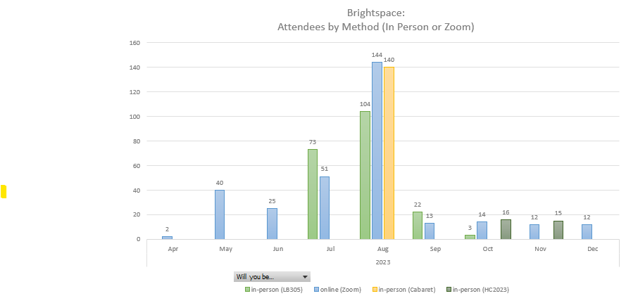
JUNE- JULY-AUG 2023
SUMMER 2023 LMS
TRANSITION PHASE II:
Short pilot period to test the new system
On June 5, 2023, the Fall 2024 Brightspace course offerings were available for instructors to begin to build their courses, which solidified the transition to full deployment.
For this transition phase courses were migrated from:
Summer 2022
Fall 2022
Winter 2023
and Spring 2023.
In July and August, a majority of 686 faculty were trained on Brightspace​
Course Migration & Deployment
The manual migration to Brightspace quality assurance tested one thousand seventy-four (1,074) Fall 2022 course offerings. ​
​

Slide 18

August
2023
S | M | T | W | T | F | S
 |  |  | 1 | 2 | 3 | 4
5 | 6 | 7 | 8 | 9 | 10 | 11
12 | 13 | 14 | 15 | 16 | 17 | 18
19 | 20 | 21 | 22 | 23 | 24 | 25
26 | 27 | 28 | 29 | 30 | 31
Unit 1
Lesson 1
Topic 1
Unit 2
Notes:
FALL 22 Courses - 1074
Question Pools - 3,296

Slide 19

September
2023
Unit 1
S | M | T | W | T | F | S
 | 1 | 2 | 3 | 4 | 5 | 6
7 | 8 | 9 | 10 | 11 | 12 | 13
14 | 15 | 16 | 17 | 18 | 19 | 20
21 | 22 | 23 | 24 | 25 | 26 | 27
28 | 29 | 30
Lesson 1
Topic 1
Unit 2

Slide 20
October
2023
S | M | T | W | T | F | S
 | 1 | 2 | 3 | 4 | 5 | 6
7 | 8 | 9 | 10 | 11 | 12 | 13
14 | 15 | 16 | 17 | 18 | 19 | 20
21 | 22 | 23 | 24 | 25 | 26 | 27
28 | 29 | 30 | 31
Unit 1
Lesson 1
Topic 1
Unit 2

Slide 21
November
2023
S | M | T | W | T | F | S
 |  |  |  |  | 1 | 2
3 | 4 | 5 | 6 | 7 | 8 | 9
10 | 11 | 12 | 13 | 14 | 15 | 16
17 | 18 | 19 | 20 | 21 | 22 | 23
24 | 25 | 26 | 27 | 28 | 29 | 30
31
Unit 1
Lesson 1
Topic 1
Unit 2

Slide 22


SEPT-NOV 2023
(70 DAYS)
Student employees quality assurance tested 1,388 Winter & Spring course offerings. These courses were re-structured using Course Builder Tool to clean misaligned content.
Bright Foxes
The Bright Fox team is comprised of Digital Education staff and student employees to visit academic schools to assist faculty in using the new Brightspace LMS.
156 Non-Credit Courses & Project sites migrated
Notes:
Winter and Spring Courses – 70 days (Sept – Nov)
Number of Courses – 1388
5.Non – credit courses and project sites – Entire Fall Semester ,
Number of Courses – 156
6.Brightspace open labs and workshops – Entire Fall and Spring Semester
7.Bright Foxes – Fall Semester
Number of workshops – 3 (edited)
Training sessions
Simultaneously, the Digital Education department was integrating external learning tools into Brightspace. The Digital Education staff implemented Zoom, TurnItIn/Examsoft, Panopto, Piazza, Perusall, Textbook Publishers including McGraw Hill, Cengage, Pearson, Macmillan, Sage Vantage, Wiley, and W.W. Norton.
On June 5, 2023, the Fall 2024 Brightspace course offerings were available for instructors to begin to build their courses, which solidified the transition to full deployment. The manual migration to Brightspace started with all courses from the last academic year on the legacy LMS. For this transition phase courses were migrated from Summer 2022, Fall 2022, Winter 2023, and Spring 2023.
FALL 2023 LMS TRANSITION PHASE II: Condensed timelines for migrating old courses
In five (5) months, the Digital Education department migrated course content for two thousand nine hundred and seventeen (2,917) Sakai courses. Over the summer into the Fall of 2023, five (5) part-time student employees quality assurance tested one thousand seventy-four (1,074) Fall 2022 course offerings. These courses were re-structured using Course Builder Tool to clean misaligned content.
The third high level milestone was reached on August 28, 2023, when instructors for Fall 2023 courses began teaching in Brightspace. Student employees continued to process one thousand three hundred eighty-eight (1,388) Winter 2023 and Spring 2023 course offerings were migrated and tested. Additionally, the quality assurance student employees manually exported, imported, and content reviewed four hundred twenty-nine (429) project sites and twenty-six (26) non-credit course offerings. Furthermore, the quality assurance student employees also migrated to two hundred twenty-five (225) question pools with over ten thousand (10,000) questions.

